Slide 1

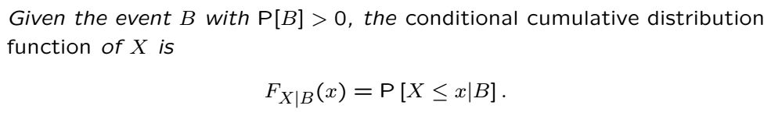

Conditioning RV on an Event
One can define conditional probabilities (see earlier lectures)
This involves conditioning on events
Earlier we saw that PMFs can be conditioned on events
One can also define conditional CDFs or PDFs.
Example:
As we saw earlier, discrete RVs one can define conditional PMFs:

Slide 2
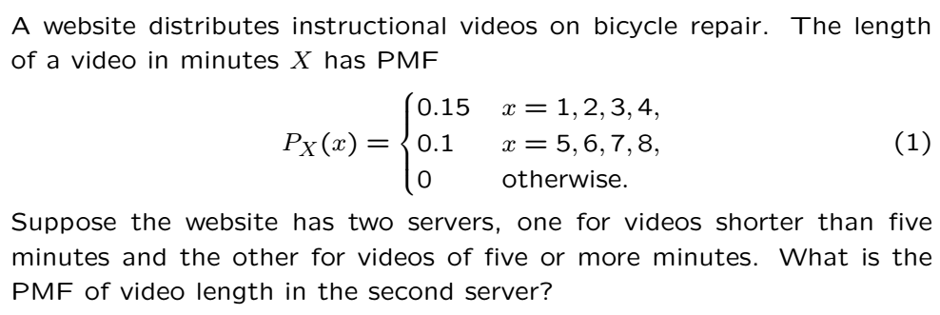
Conditioning RV on an Event (PMF Example)
Before we do general RVs conditioned on an event, we revisit it for PMFs

Slide 3
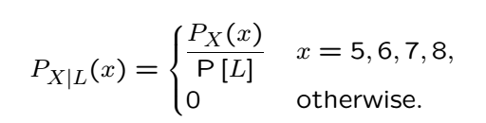

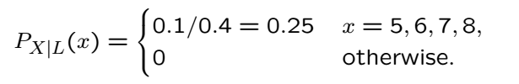
Solution

Slide 4
Acknowledgements and Citations
Parts of these slides are adapted from the following resources:
Power Point Lecture Slides for the Textbook http://bcs.wiley.com/hebcs/Books?action=index&bcsId=8676&itemId=1118324560
John Tsitsiklis. 6.041 Probabilistic Systems Analysis and Applied Probability, Fall 2010. (Massachusetts Institute of Technology: MIT OpenCourseWare),http://ocw.mit.edu (Accessed 13 Apr, 2015). License: Creative Commons BY-NC-SA

